Slide 1
Online Library Management System

Slide 2
What Online Library Management System App For?
For managing and automation Library management
For both Users and Administrators of Library
Administrators – Can manage Books, Authors, Genres and User
Admin – Can borrow and take books to Users(Automated)
Users – Can see which books they have taken from library
Functionalities – Without any registration or logging in all users can see our available books(Contains searching also)

Slide 3
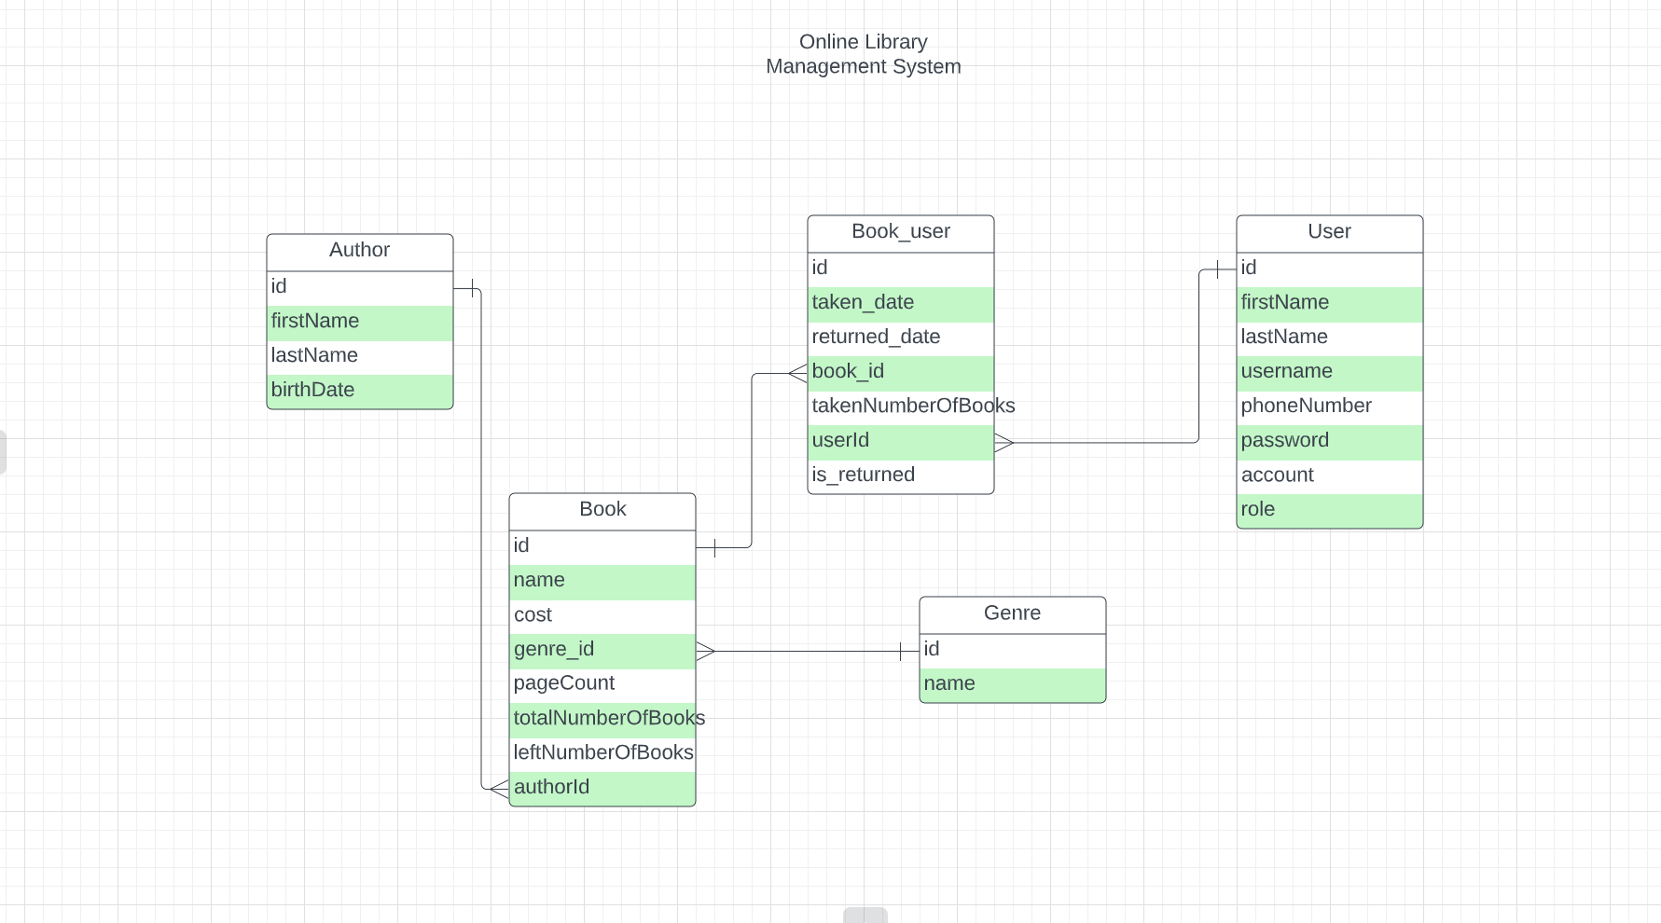
Message
Payment
Id
Text
Customer id
Manager id
Id
Order
Amount

Slide 4
Used Technologies
Java 11
JDBC
Servlets(JSP, JSTL)
Database(Postgrssql)

Slide 5
Entities
Book
User
Author
Genre
Book_User

Slide 6
Author and Genre
Contains Author and Genre information in separate table

Slide 7
Book
Contains book information with Author, Genre relation

Slide 8
User
Contains user information with
Users Role
There will be two roles
User – can see taken books and available books
Admin – can manage all contents like Author(CRUD), Genre(CRUD), Book(CRUD) and can add Admin also

Slide 9
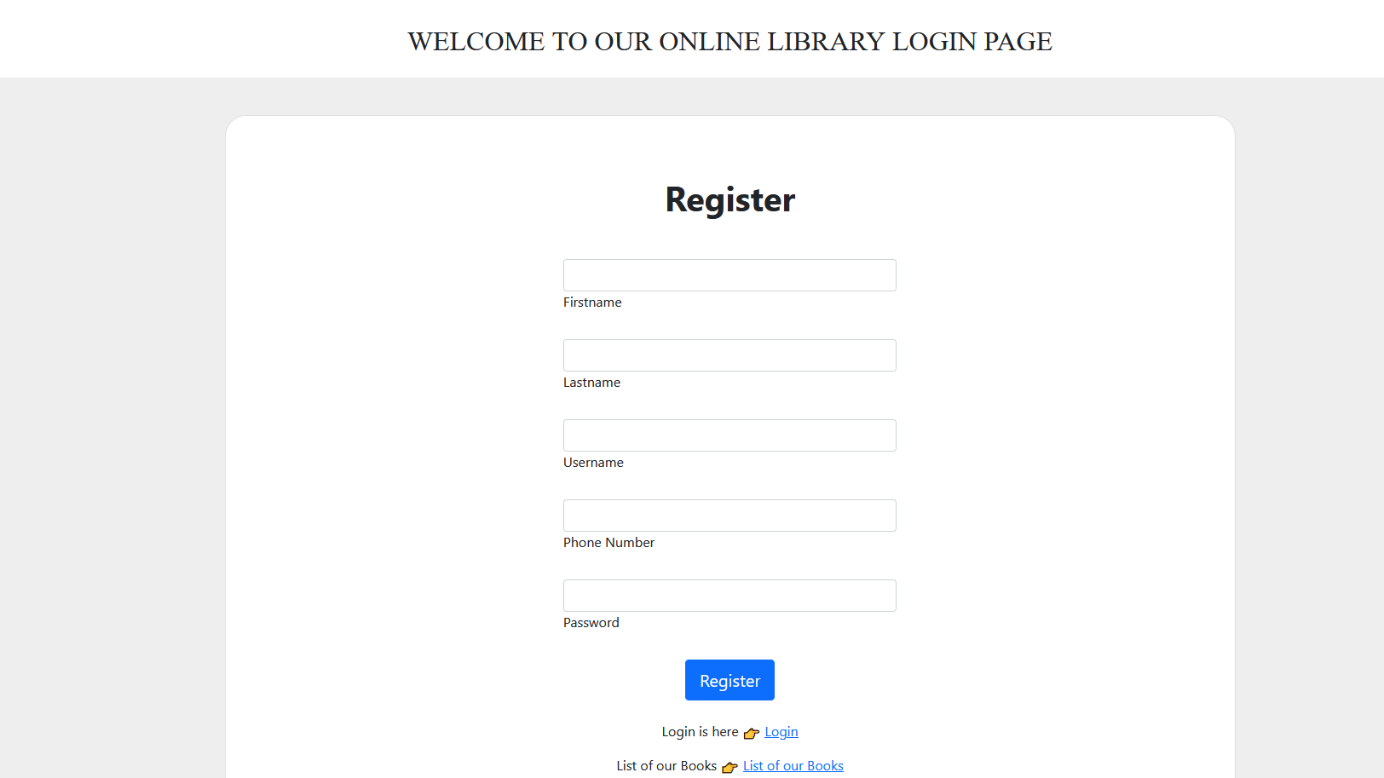
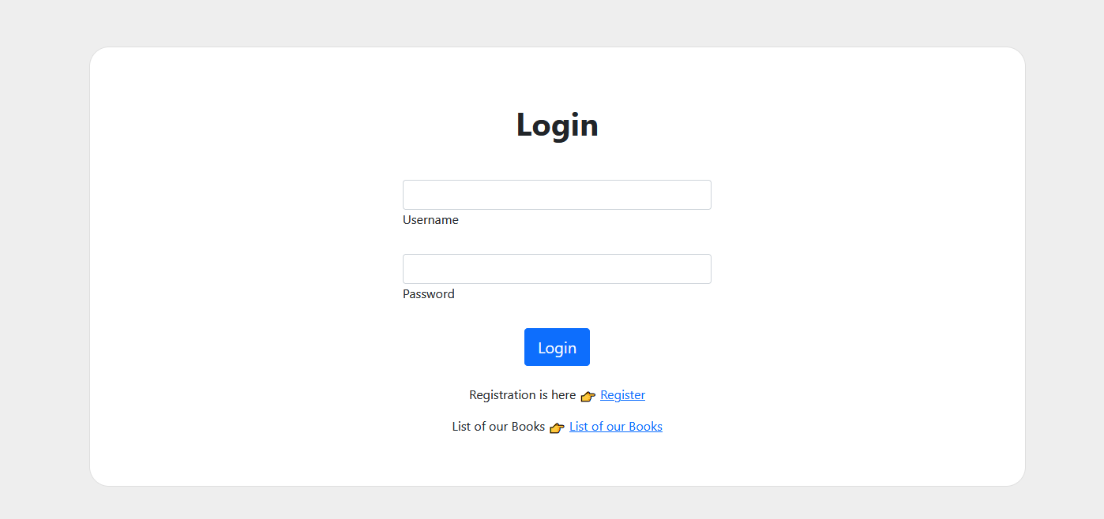
Features of Web Application

Slide 10
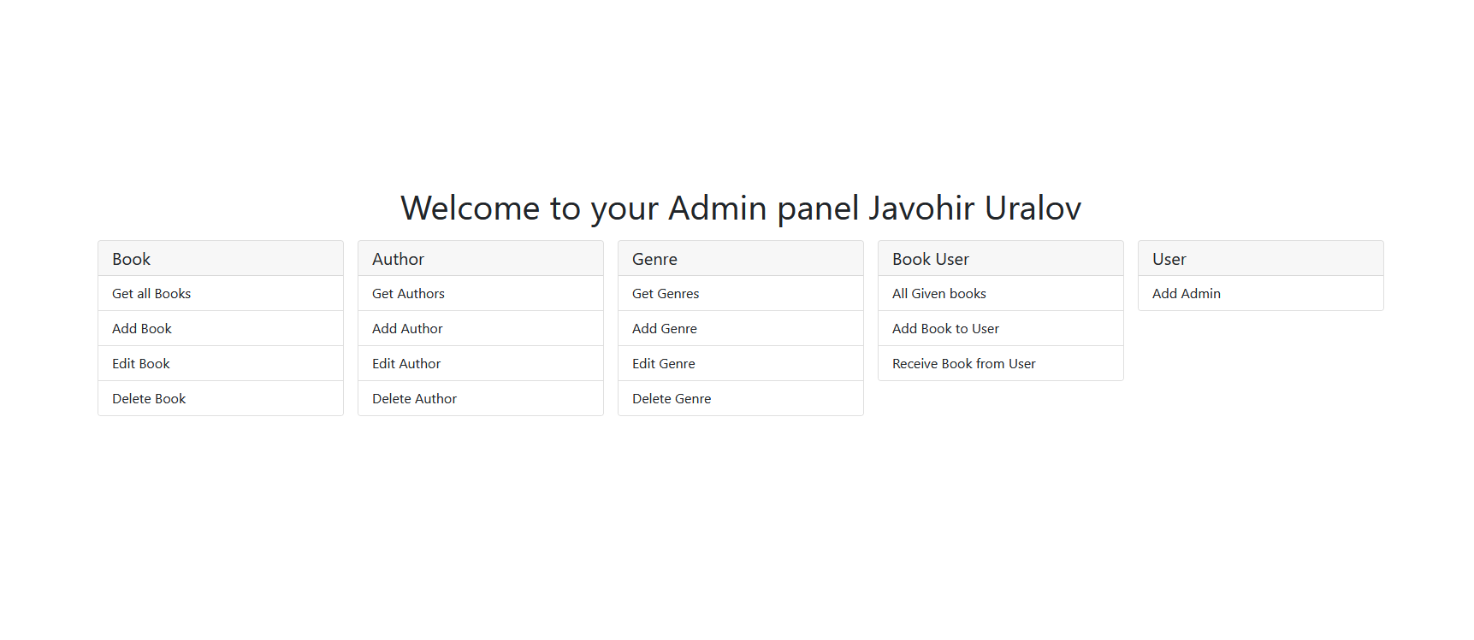
Admin panel features

